Slide 1
Marwadi Food

Slide 2

Team Members
Internal guide
Name- Mohammad Asif Raja
Enroll- 91900103123
Class- 7TC3
Name- Mohammad Asif Raja
Enroll- 91900103094
Class- 7TC3
Name- Jaydeep Ratanpara

Slide 3
Introduction
This project aims to provide and develop the Canteen/Mesh daily food menu and ordering system .
The development of this website needs the resource of daily analysis of food system in university and be responsive according to the food management committee.
The development of this project will include the assessment from the food department, students reviews, mesh staffs/workers and some of the faculties as well.
Then analyzing from the software development methodologies we are involving different approach on management in food and menu sector in our next step through implementing it in web based application.

Slide 4
Motive
Since the previous apps and websites regarding to our university food were not able to perform well as they have not been updated from a long time so the students and the faculties were unable to get the information about the food which is available at a particular date in a mesh.
This project will include food menu list for four times meal of a day i.e. (breakfast, lunch, snacks and dinner) provided by the university food department.
Our website will take care of feedbacks of the food consumers as there was no any proper review system earlier in our university.
Earlier if there were any changes made in the food menu then there were no any updates made or no any notification in the existing systems so the consumers would have to face various problems.

Slide 5
Motive
The User Interface (UI) of previous system were not so interactive and informative to the users, So the user were not much interested in those system. There were no any proper facilities to inform food department about the student/consumers information when they were having some health issues due to which they were unable to have meals at proper time leading further illness to the consumer.
The previous system were only targeted to hostel students neglecting the other consumers like faculties and out of hostel students.
And the previous system was app based so the user need to download it and the loading of the app consumed more time moreover this wasted their precious time being user unfriendly too.

Slide 6
Technology
HTML CSS
Java Script
PHP

Slide 7
Technology
MySQL
jQuery
Bootstrap

Slide 8
Project Goals
The motive of this project is to make user friendly and responsive system for the user. We also are planning to include the ordering system for the users who are unable to reach the mesh due to their health issues or any other personal issues.
We are including user to wide variety including hostel students, normal out- student, faculties and also the special visitors in university.
We are also giving some space for the user to give their personal feedback regarding the food they consume which may be positive/negative response, enabling food department to make any changes if required.
This project will save the time which the user used to waste in the previous systems.

Slide 9
Output
Fast & Responsive
Effective update
Attractive User Interface
Wide variety of Users
Easy and User friendly

Slide 10
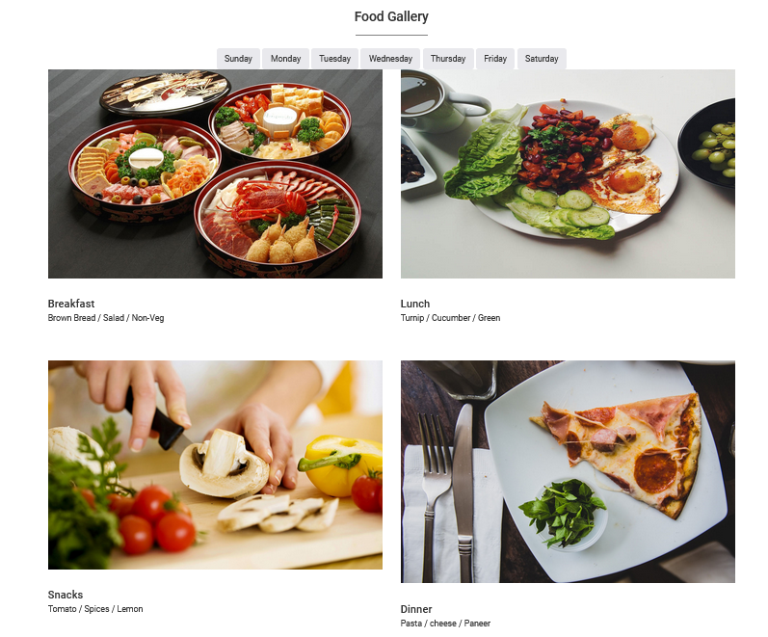
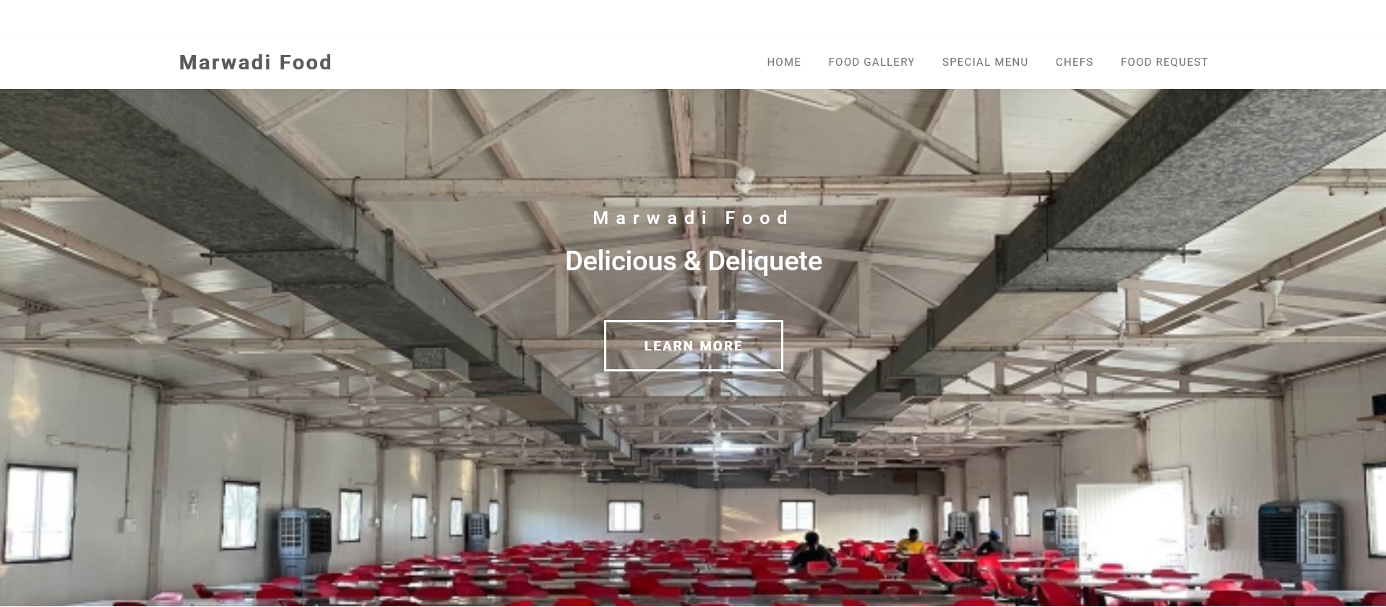
Some User Interfaces

Slide 11
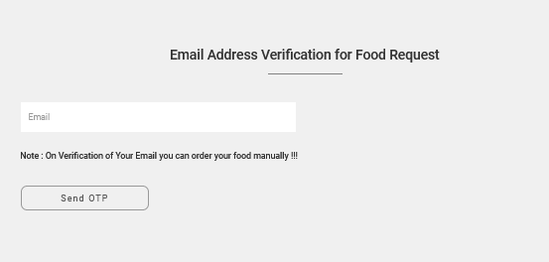
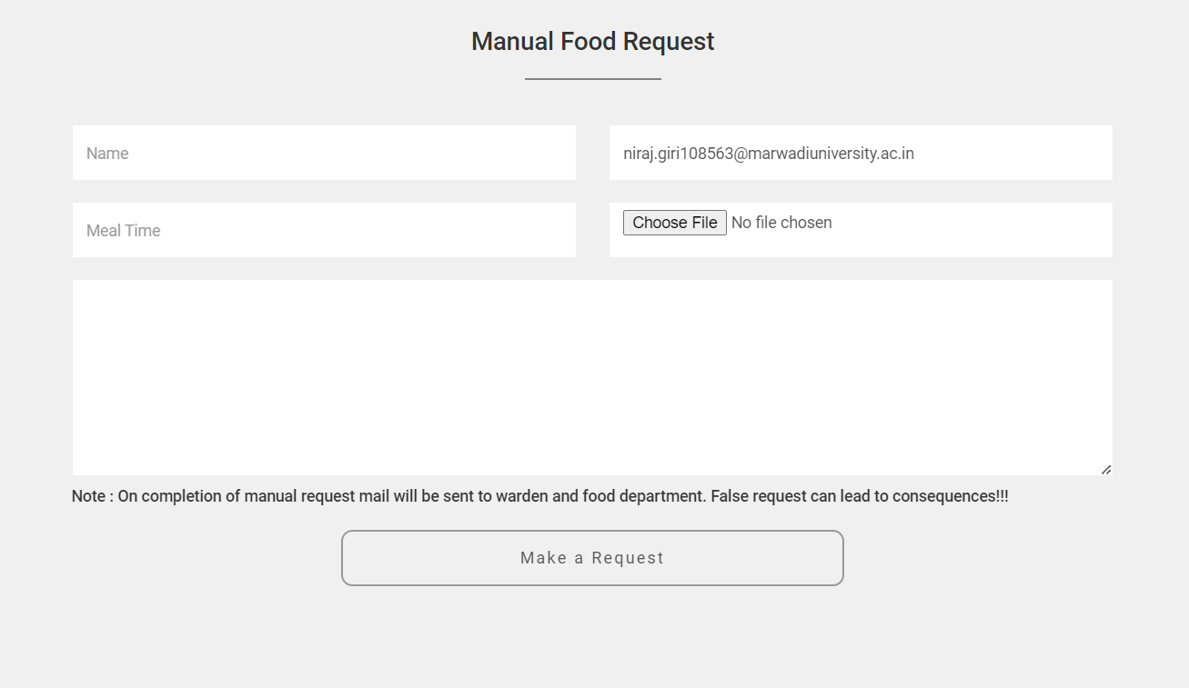
Manual order/request section for hostellites

Slide 12
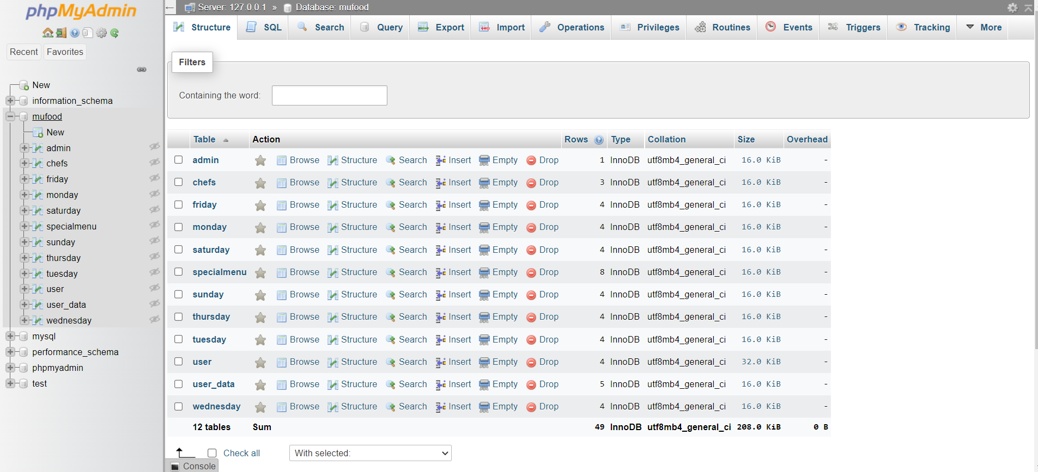
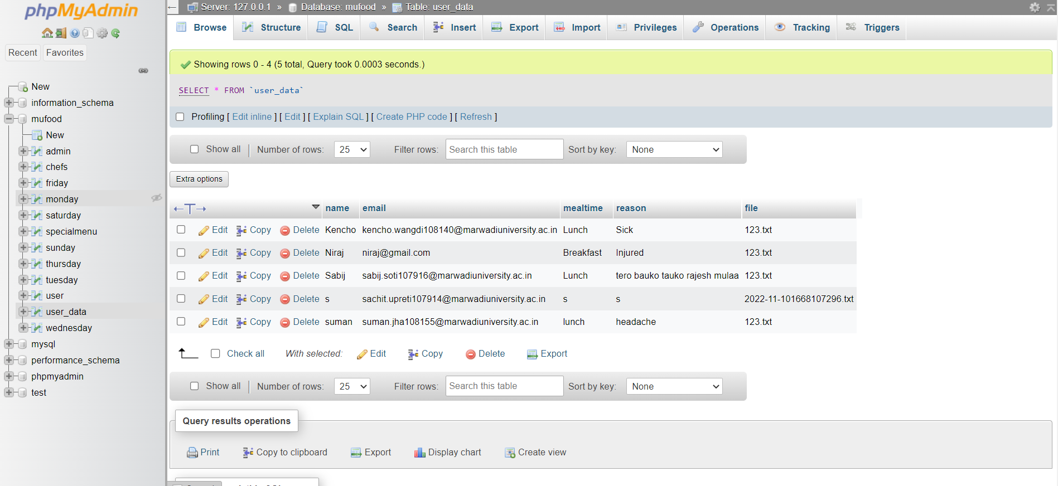
Databases Table/Design

Slide 13
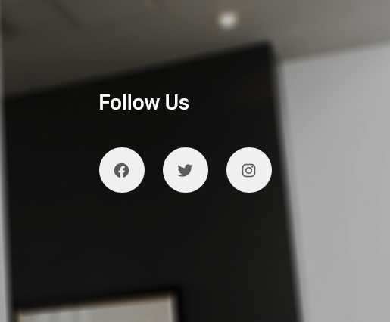
Linked Social Medias

Slide 14
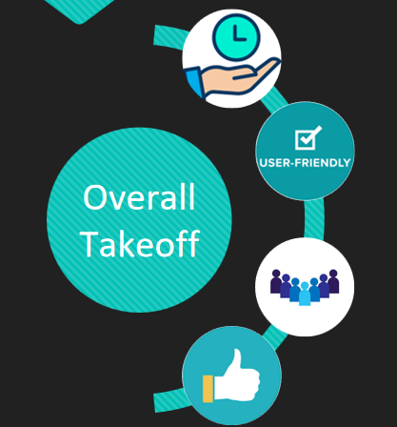
Summary
Time Saving
User Friendly UI
Wide Range Of Users
User Feedback Accepted

Slide 15
Future Enhancements
We will try to make our web application to mobile application.
We can work further more on the data security of the user.
We can use some of the Artificial technologies to make our website more interactive with the users.

Slide 16
References
MU FOOD Application
www.javatpoint.com
www.w3school.com

Slide 17
Thank You

